Slide 1
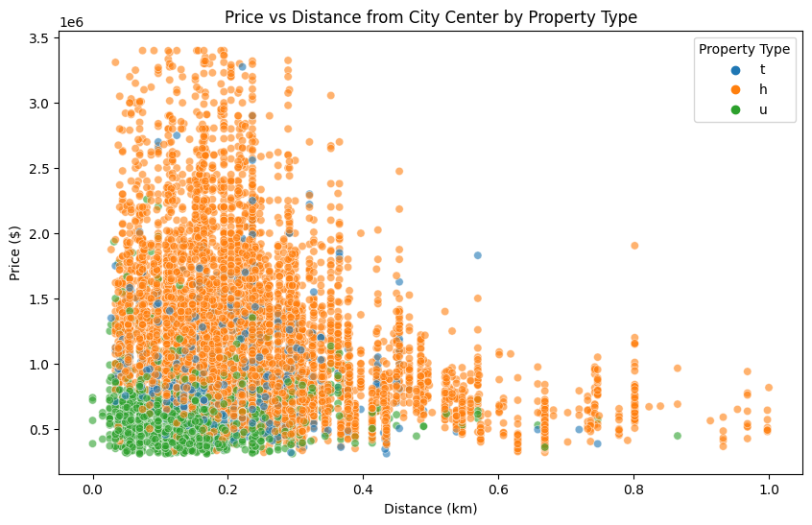
Question 2 Optimal Location for Real Estate Investment: Price vs Distance from City Center by Property Type
Explanation: This graph illustrates how property prices vary with the distance from the city center, categorized by property type.
Inference: Properties closer to the city center tend to be higher in price, with variations based on property type.

Slide 2
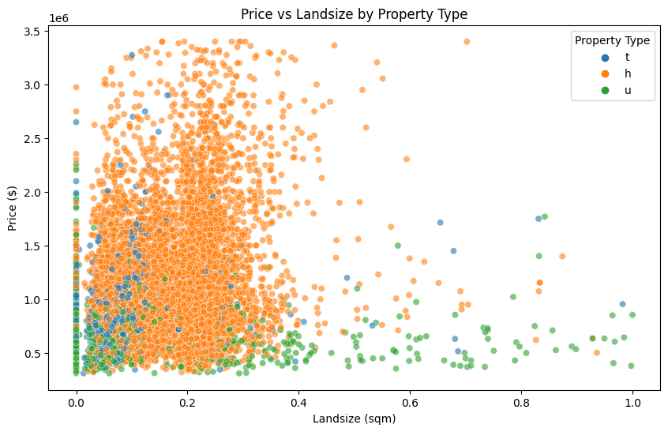
Price vs Landsize by Property Type
Explanation: This plot shows the relationship between property prices and land size, differentiated by property type.
Inference: Larger land sizes usually command higher prices, with variations across different property types.
For example houses in remote areas will be higher in land value and lower in Price.

Slide 3
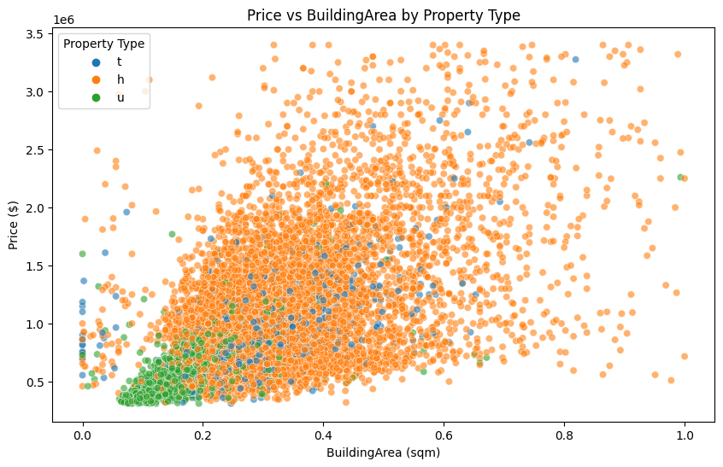
Price vs Building Area by Property Type
Explanation: This visualization depicts the correlation between property prices and building area, distinguished by property type.
Inference: Generally, larger building areas are associated with higher property prices, though this varies by type.

Slide 4
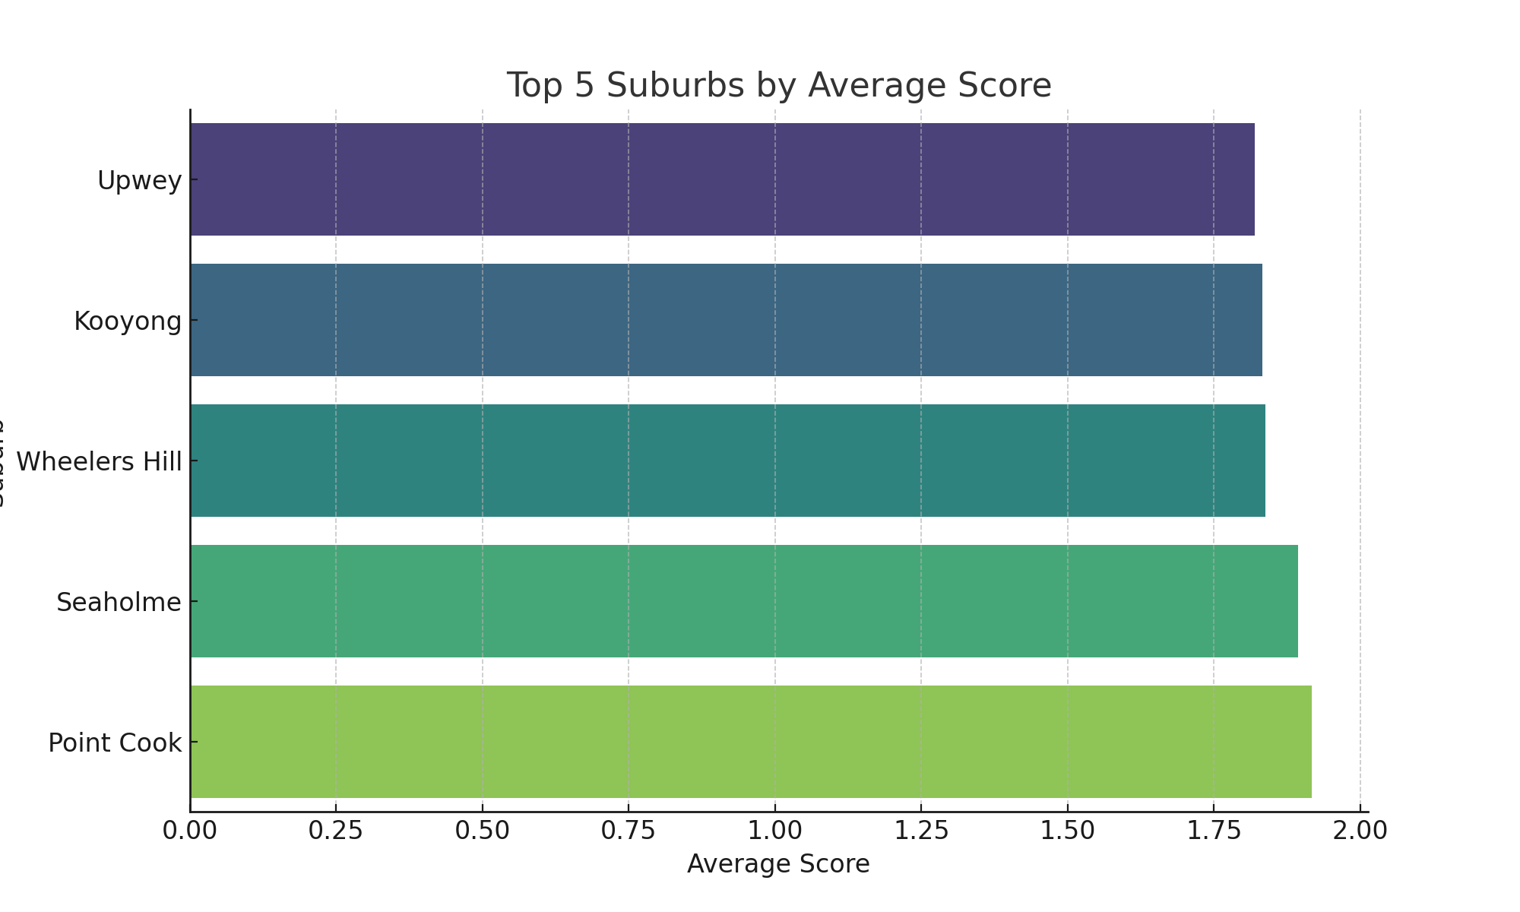
Top 5 Suburbs by Average Score
Explanation: This bar graph ranks the top 5 suburbs in Melbourne based on a composite score from various property features.
Inference: Suburbs like Point Cook and Seaholme rank highest, indicating favorable property features.

Slide 5
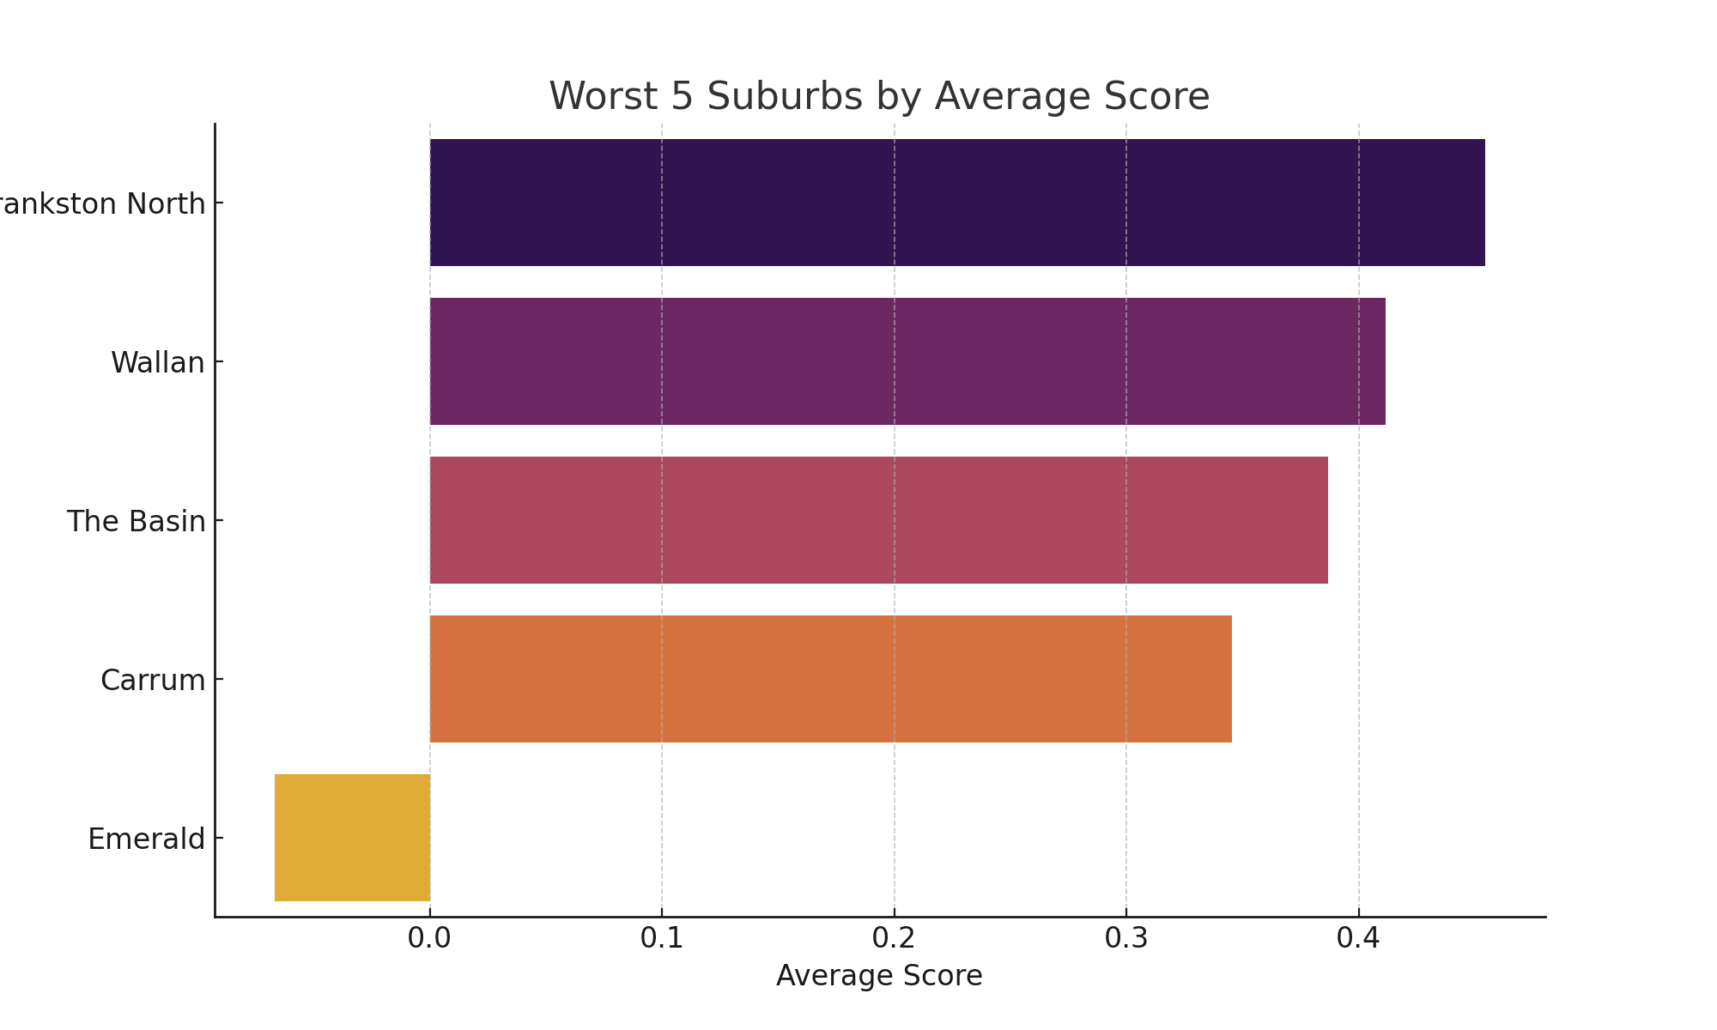
Worst 5 Suburbs by Average Score
Explanation: This graph shows the suburbs with the lowest scores, reflecting less favorable property characteristics.
Inference: Suburbs such as Emerald and Carrum have lower scores, suggesting less desirable aspects.

